Slide 1
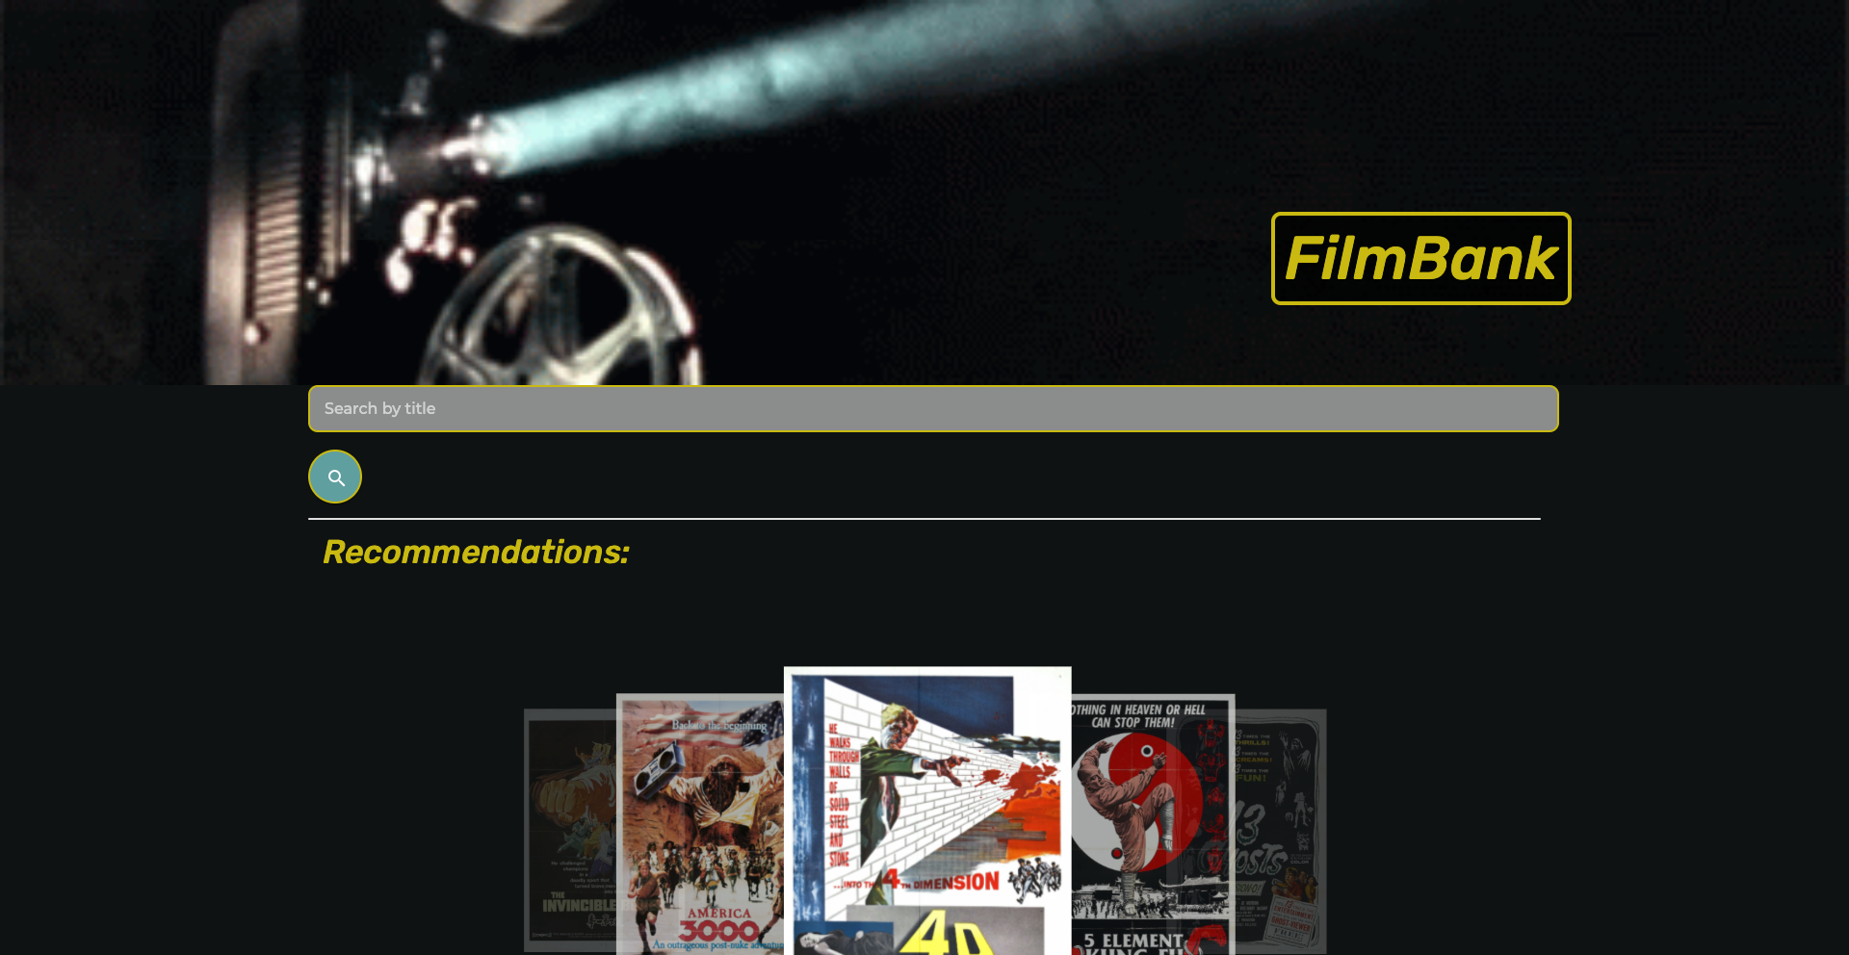
Joey Castillo
Lisa Goodell
Yihsien Lu
Scott Willrich

Slide 2
Agenda
Elevator Pitch
Concept
Process
Demo
Future Development / Enhancements
Links
Questions

Slide 3
Elevator Pitch
FilmBank gives a user the ability to:
Search for a film from any time in any genre
See a list of films that meet the search criteria
Get a description of any film including:
Description
Release Date
Cast
Where It’s Streaming
New York Times Movie Review

Slide 4
Motivation / User Story
With the COVID-19 lockdown, everyone needs more ways to spend their free time while stuck at home.
Give the public ideas for entertainment and ways to choose the best films to watch
GIVEN that I am interested in
information about a particular film,
WHEN I search for a film
THEN I see the poster and
basic information about the film.
WHEN I want to find where
a file is streaming
THEN I see a listing of
streaming providers

Slide 5
Concept
FilmBank gives a user the ability to:
Search for a film from any time in any genre
See a list of films that meet the search criteria
Get a description of any film including:
Description
Release Date
Cast
Where It’s Streaming
New York Times Movie Review

Slide 6
Technology
HTML
Materialize CSS
JavaScript
The Movie Database (TMDB) API
The New York Times Movie Review API

Slide 7
Collaboration & Division of Work
Difficult on Small Project
Collaboration on Concept / CSS Framework Selection
Roles (shared as much as possible)
HTML Development
JavaScript Development
Incorporation of Materialize
Slide / README Development
Project Management

Slide 8
Challenges We Overcame
Small Project - Division of Work
Finding an API that provided the information we needed
GitHub - Branching and Merging
Learning a New CSS Framework

Slide 9
Filmbank Demo

Slide 10
Enhancements / Future Development
Incorporating Additional Data
TV Shows
Links to Streaming Providers
Film Trailers
Actor Bios
What’s in Theaters
Mark a Movie as a Favorite

Slide 11
Links
Deployed Application
https://swillrich5.github.io/filmbank/
GitHub Repository
https://github.com/swillrich5/filmbank/
Developers
Joey Castillo | joeycastilloo558@gmail.com
Lisa Goodell | robotsinboxes@gmail.com
Yihsien Lu | alecfirstapple@gmail.com
Scott Willrich | swillrich@gmail.com

Slide 12

Thank You / Questions

